Slide 1
Python

Slide 2
Intro
Python is a general-purpose interpreted, interactive, object-oriented, and high-level programming language
It was created by Guido van Rossum during 1985- 1990
Python source code is also available under the GNU General Public License (GPL)
Python standard library is very portable and cross-platform compatible on UNIX, Windows, and Macintosh
Python Official Website : http://www.python.org/

Slide 3
Overview
Python is Interpreted: Python is processed at runtime by the interpreter.
You do not need to compile your program before executing it
Python is Interactive: You can actually sit at a Python prompt and interact with the interpreter directly to write your programs
Python is Object-Oriented: Python supports Object-Oriented style or technique of programming that encapsulates code within objects.

Slide 4
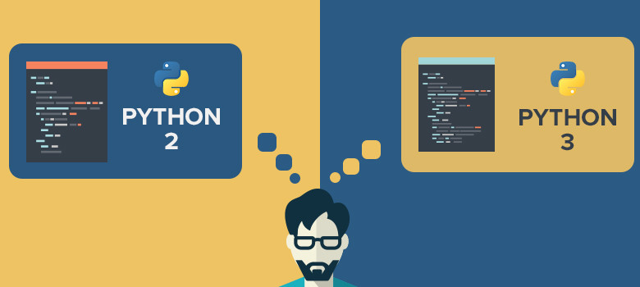
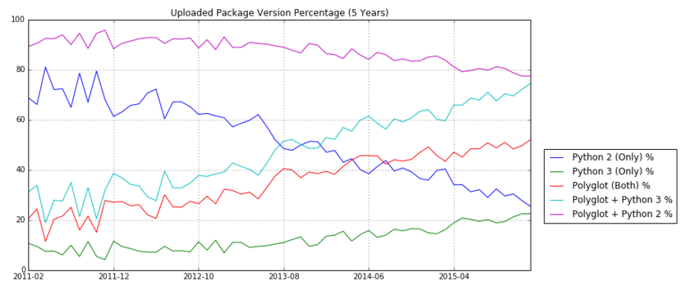
Python big fork
Take-home message: Uploaded Packages are increasingly containing Python 3 support and decreasingly containing Python 2 support.

Slide 5

Installing Python
For any Python installation, I strongly recommend that you use Python versions 3.x
You have 2 options:
Install the basic Python interpreter
https://www.python.org/downloads/
(my recommendation) Install a bundle of Python interpreter and numerous useful/popular modules
I recommend the Anaconda distribution
https://www.continuum.io/downloads

Slide 6
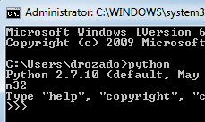
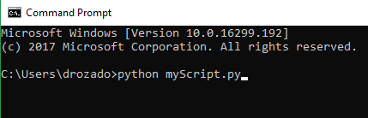
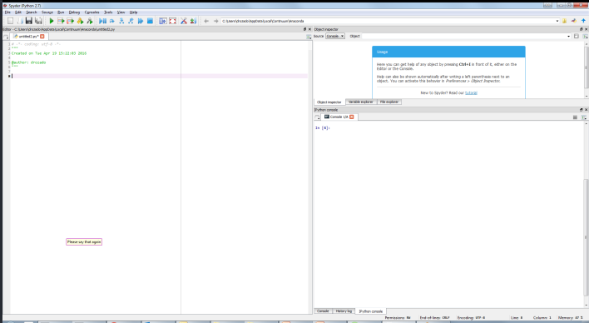
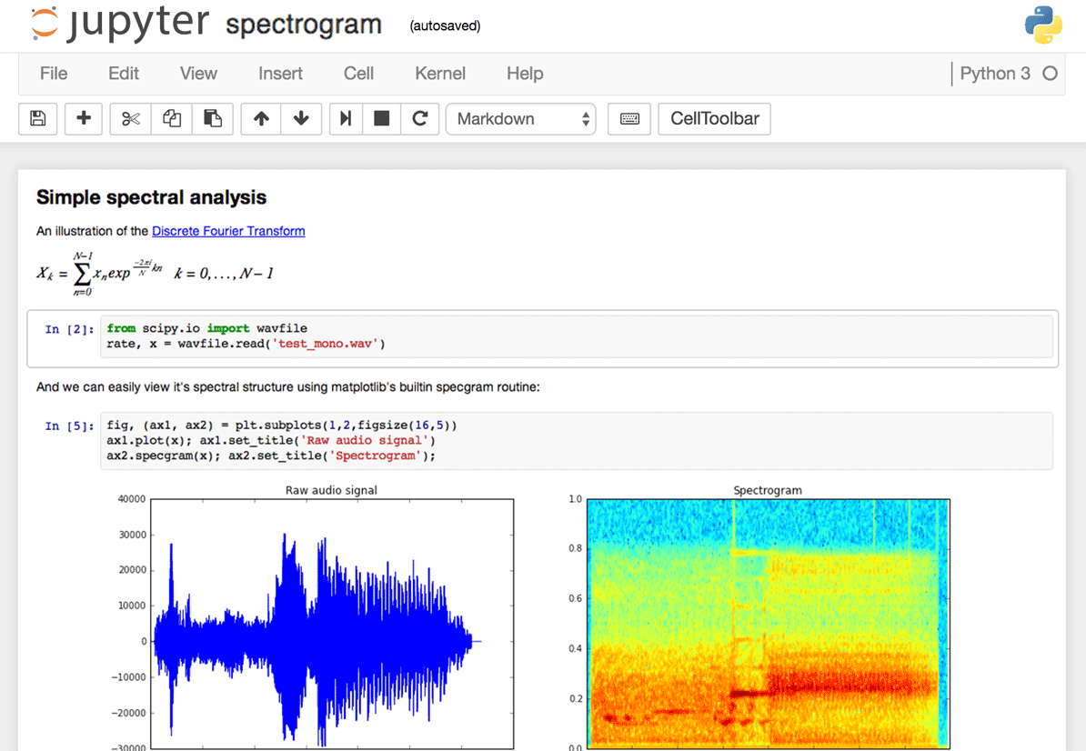
Running Python
Interactive Interpreter
Script executed from the command line
Integrated development environment (IDE)
Jupyter/Python notebooks

Slide 7
Jupyter notebooks
The Jupyter Notebook is an open-source web application that allows you to create and share documents that contain live code, equations, visualizations and narrative text.
Notebook documents are both human-readable documents containing the analysis description and the results (figures, tables, etc..) as well as executable documents which can be run to perform data analysis.
The Jupyter Notebook App is a server-client application that allows editing and running notebook documents via a web browser. The Jupyter Notebook App can be executed on a local desktop requiring no internet access or can be installed on a remote server and accessed through the internet.
A notebook kernel is a “computational engine” that executes the code contained in a Notebook document.
When you open a Notebook document, the associated kernel is automatically launched. When the notebook is executed (either cell-by-cell or with menu Cell -> Run All), the kernel performs the computation and produces the results.
Uses include: data cleaning and transformation, numerical simulation, statistical modeling, data visualization, machine learning, and much more.
Productivity tips:
Shift+tab in Jupyter notebook opens up in line information about a method/function
Control + I in Spyder does a similar thing
Both help you to avoid having to do repetitive Google searches about a given function

